Slide 1



Hydrodynamic Modeling Improvements for Floating Offshore Wind Turbines with Validation Results
Doyal Sarker, Md Sakif, Tri Ngo, Tuhin Das
Department of Mechanical and Aerospace Engineering
University of Central Florida (UCF)
Date: 06 October 2025
Presented by: Doyal Sarker

Slide 2
Introduction and Motivation
Offshore Wind Energy - Clean, resilient and sustainable energy
Challenge: accurate hydrodynamic load modeling for stability and performance.
Resonance mode of Floating offshore wind turbine (FOWT)
Second order wave load excite low-frequency response
Potential Flow Theory
- Captures radiation & Diffraction (neglects Drag)
- Requires frequency dependent coefficients
Morison’s Equation
- Efficient, distributed loads along the member
- Pre-knowledge on hydrodynamic coefficients

Slide 3
Study Contributions
Enhance hydrodynamic modeling capability within CRAFTS simulator with validation studies
Second order wave loads improves the LF resonance responses of platform’s mode .
Vertical wave stretching counters the under-prediction of LF surge response.
Diffraction correction by MacCamy-Fuchs (MCF) theory for large diameter structure.
Spatial distributed load on pontoon.
Enhanced modeling efforts have been validated on VolturnUS-S semi-submersible floating platform.

Slide 4
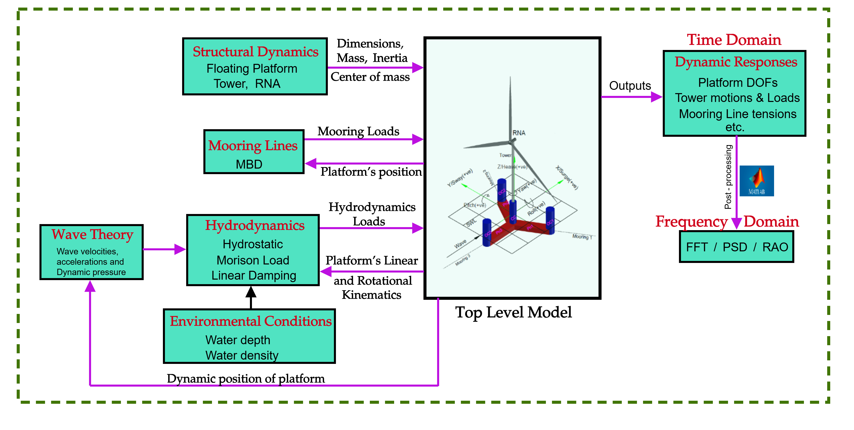
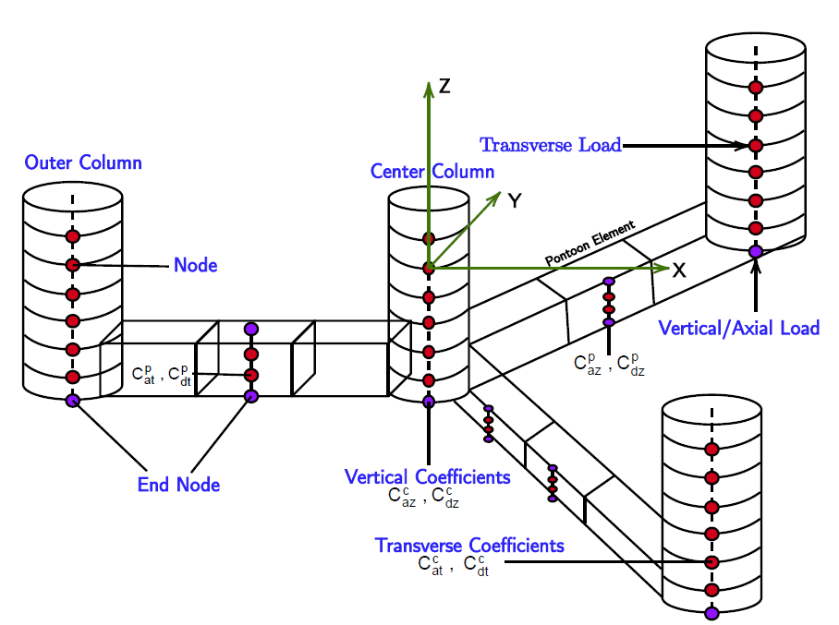
Numerical Modeling
CRAFTS (Control, Oriented-Reconfigurable, and Acausal Floating Turbine Simulator
Acausal modeling, Modelica Language, Component level modeling
Generalized and reusable model with user defined data inputs
Hydrodynamics Module
Linear Hydrostatic
Morison Equation (Added mass + Drag + Wave Excitation)
Mooring Loads
Component level hydrodynamics
Spatial Wave kinematics
Structure specific hydro coefficients

Slide 5
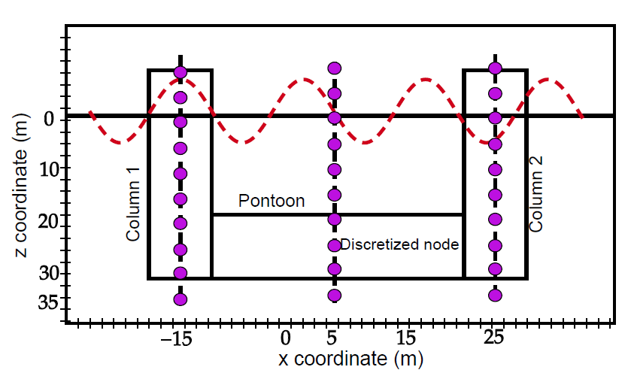
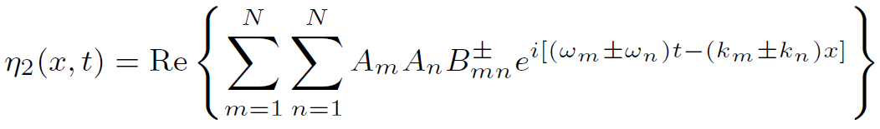
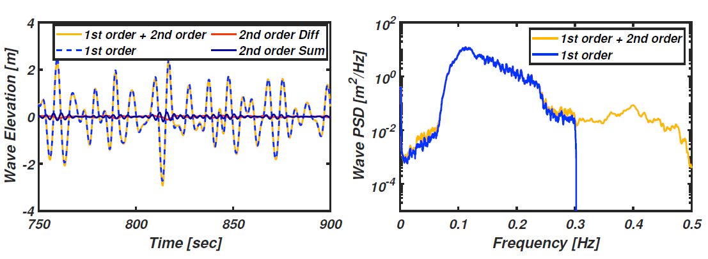
Hydrodynamics Modeling Improvements
Current Modeling limitation
First order linear wave loading
Diffraction effects are negligible
Wave loads computation up to mean sea water level (SWL)
Treated large structure as single element
Second-order wave and Spatial effects
Difference and summation frequency wave kinematics
Excite the platform’s LF natural modes and HF tower response
Spatially consistent wave kinematics
for large floating structures
Phase differences in wave excitation forces.
Wave kinematics interpolated at displaced nodal z-positions.

Slide 6
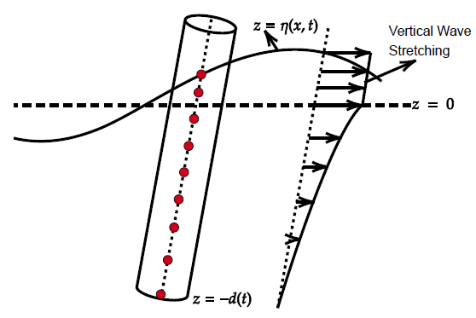
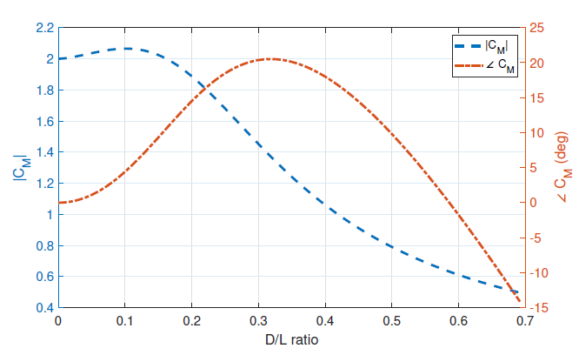
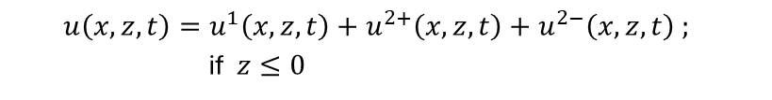
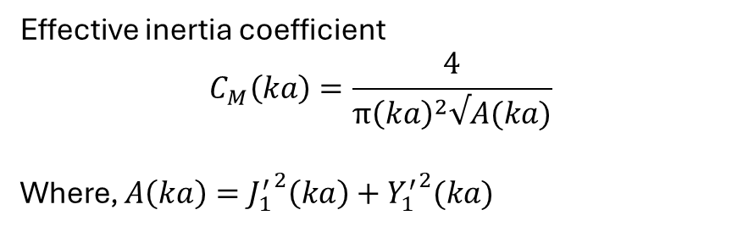
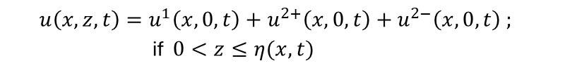
Hydrodynamics Modeling Improvements
Vertical wave stretching (VWS)
Wave excitation loads are more sensitive to near free-surface (FS)
Without WS – underpredict the excitation force
Wave drift loading are prominent to drag loading near to FS
Diffraction Correction (MacCamy-Fuchs diffraction)
Become dominant for short wave-length; D/L > 0.2
Modify the constant added mass via inertia coefficient
Effective inertia coefficient
$$C_{M}\left(ka\right)=\frac{4}{π{\left(ka\right)}^{2}√A(ka)}$$
Where, $A\left(ka\right)={J_{1}^{′}}^{2}\left(ka\right)+{Y_{1}^{′}}^{2}(ka)$
For example, wave velocity
$$u\left(x,z,t\right)=u^{1}\left(x,z,t\right)+u^{2+}\left(x,z,t\right)+u^{2−}\left(x,z,t\right) ;$$
if $z≤0$
$$u\left(x,z,t\right)=u^{1}\left(x,0,t\right)+u^{2+}\left(x,0,t\right)+u^{2−}\left(x,0,t\right) ;$$
if $0<z≤η(x,t)$

Slide 7
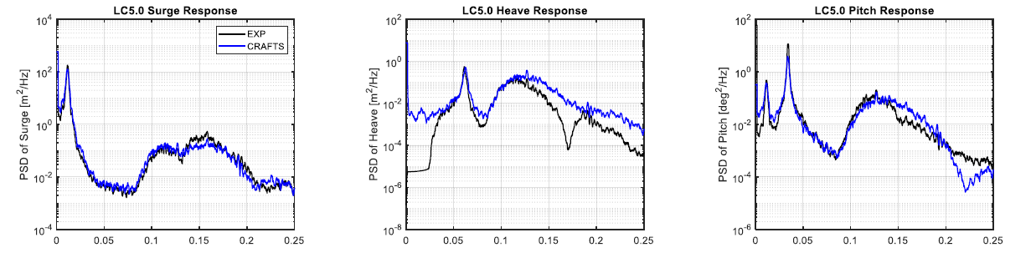
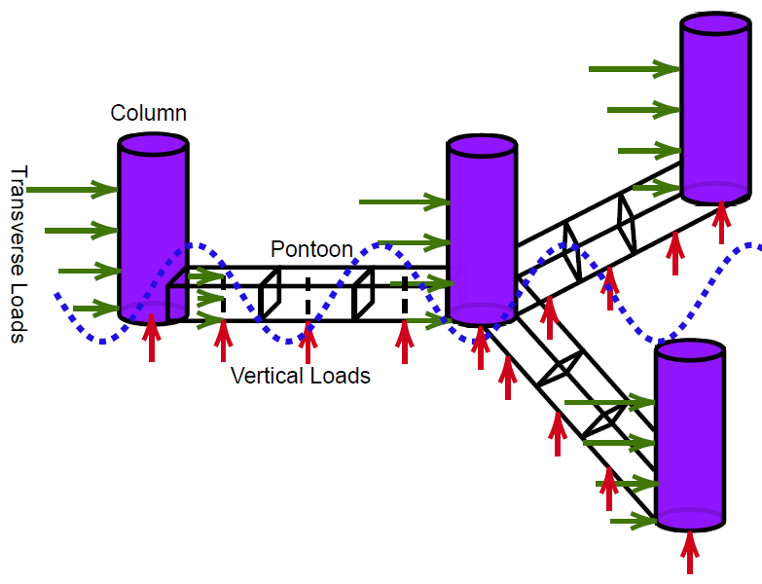
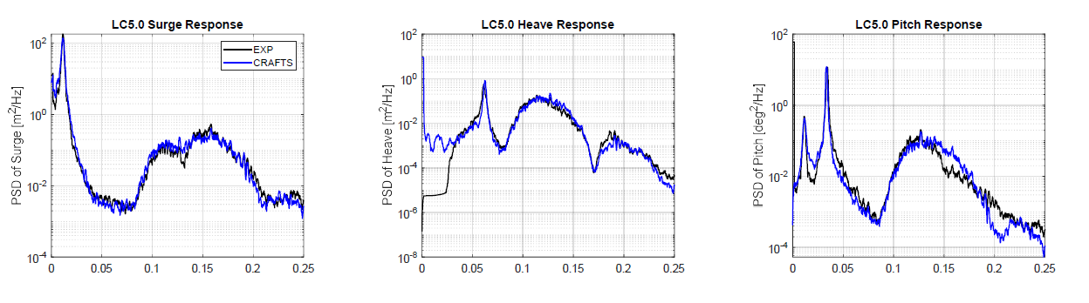
Hydrodynamics Modeling Improvements
Component-based spatial discretization
Morison equation is extended for pontoon structure
Single point lump load calculation and application
Spatial distribution wave loading efficiency
Specially the vertical loading
Enhances WF heave and pitch fidelity
Lump load
Spatially distributed load

Slide 8
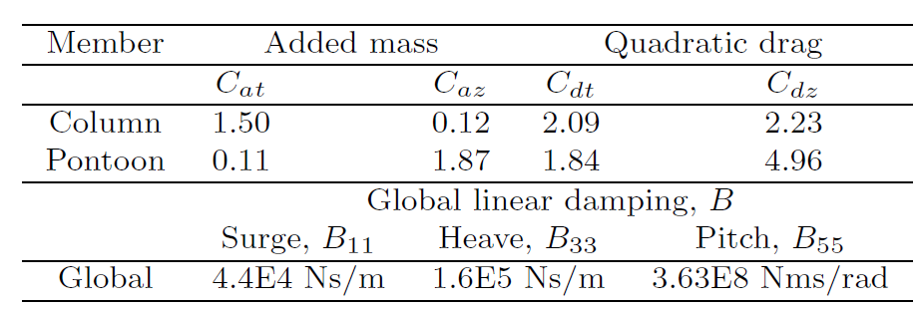
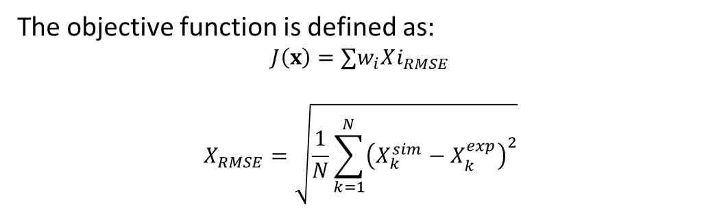
Validation Results
The FOCAL experimental campaigns were conducted at the Alfond Wind-Wave Ocean Engineering Laboratory (W2) at the University of Maine, using a 1:70 Froude-scaled model of the FOWT. Validation is performed on full-scale model and the experimental data for full scale is at https://a2e.energy.gov/ds/focal/focal.campaign4.
Hydrodynamic coefficients Calibration
Free-decay tests → tuned hydrodynamic coefficients using Genetic Algorithm optimization.
Coefficients calibrated per member (columns, pontoons)
Parameters: Added mass (Ca), drag (Cd), extra damping (B).
Additional linear damping to compensate radiation damping.
The objective function is defined as:
$$J\left(x\right)=∑w_{i}Xi_{RMSE}$$
$$X_{RMSE}=\sqrt{\frac{1}{N}\sum_{k=1}^{N}{{\left(X_{k}^{sim}−X_{k}^{exp}\right)}^{2}}}$$
Free decay tuned coefficients
x is the design variable vector of hydrodynamic coefficients.
Index i = 1, 2, 3 denotes surge, heave, and pitch, w is the weight, and X is the time series free decay response.

Slide 9
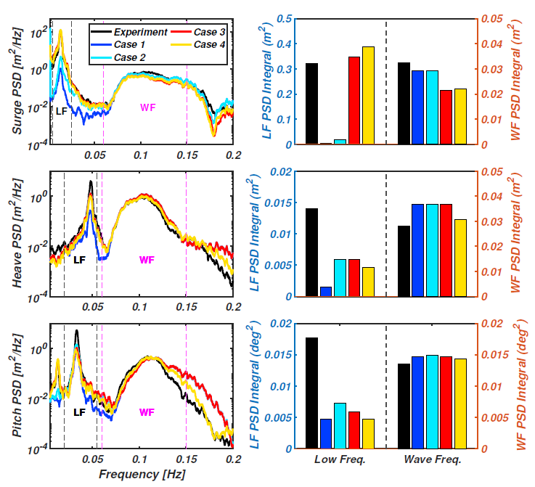
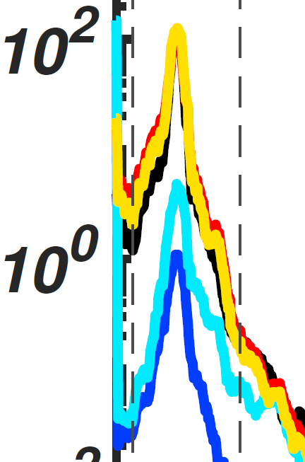
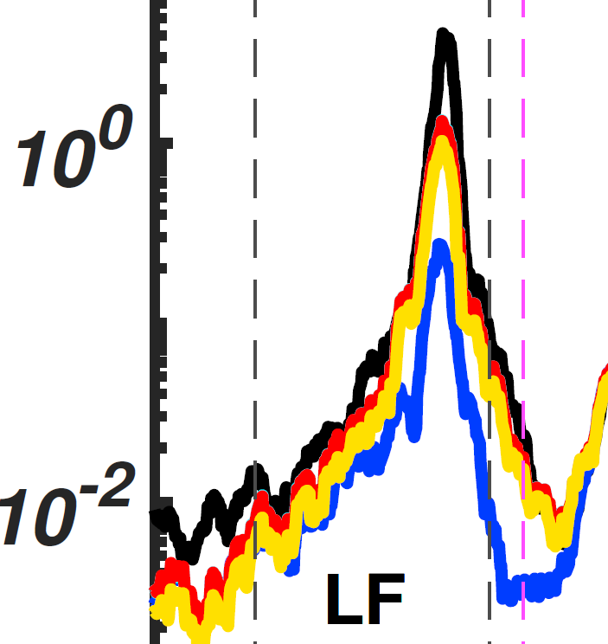
Validation Results
Irregular wave testing
Irregular wave propagation 0° heading; only the significant responses in surge, heave, and pitch are discussed.
Progressive cases are defined as:
Case 1: 1st order wave only
Case 3: 2nd order wave + VWS + MCF
Case 2: 2nd order wave
Case 4: Case 3 + Pontoon load discretization
Irregular wave 1 (Lower sea state: Hs = 3.1 m, Tp = 8.96 sec)
 | LF Surge | LF Heave | LF Pitch | WF Mode
Frequency (Hz) | 0.005-0.025 | 0.02-0.055 | 0.02-0.055 | 0.06-0.15
Key findings:
Case 1: Better agreement in WF response for all modes
Case 2: Improved LF heave and pitch responses
Case 3: Improved LF surge, better surge-pitch coupling
Case 4: Better agreement in WF heave response

Slide 10
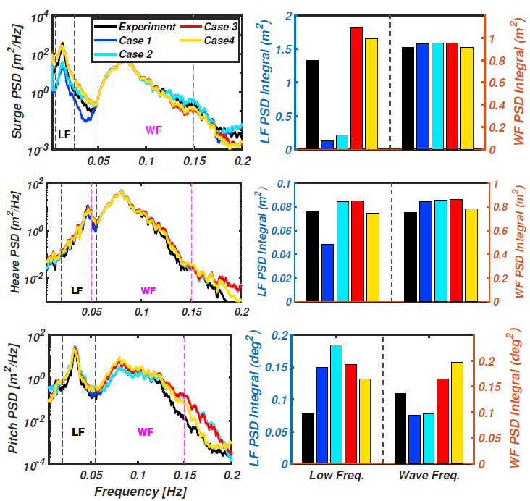
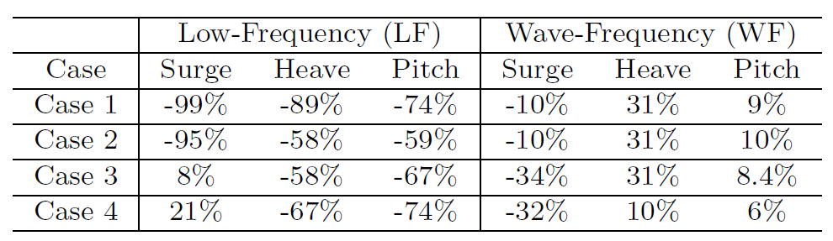
Validation Results
Irregular wave 2 (Higher sea state: Hs = 8.1 m, Tp = 12.8 sec)
 | LF Surge | LF Heave | LF Pitch | WF Mode
Frequency (Hz) | 0.005-0.025 | 0.02-0.055 | 0.02-0.055 | 0.05-0.15
Key findings:
Follows the same improvements as earlier
At higher sea-state Morison outperforms the lower sea state (WF surge)
LF response – Decay tuned coefficients needs recalibration based on irregular wave
PSD integral error compared to experiment

Slide 11
Conclusion and Future works
The study demonstrates effective hydrodynamic modeling enhancements for FOWTs using the Morison equation. Key improvements include second-order wave kinematics, vertical wave stretching, diffraction correction, and pontoon load discretization, validated by experimental data.
Enhancements:
Nonlinear wave kinematics → better LF resonance capture.
VWS + MCF → improved surge/pitch accuracy.
Pontoon discretization → better WF heave/pitch.
Limitations:
Damping calibrated in calm-water decay, not sea-state-specific.
Future:
Future efforts will address sea-state-dependent damping calibration through optimization to further increase model fidelity.

Slide 12



Thank You
Project funded by the U.S. DoE Advanced Research Projects Agency for Energy (ARPA-E)
ATLANTIS program – Phase 1 & 2

